Slide 1
Understand the use of testing and quality assurance methodologies to seek out problems and issues

Slide 2
Previously we covered:
Concept testing:
The process of using surveys (and sometimes qualitative methods) to evaluate consumer acceptance of a new product idea prior to the introduction of a product to the market
If we build <this> will you buy it? With money? Please?

Slide 3
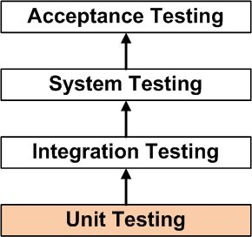
Previously we covered:
Unit testing:
where individual units / components of a software are tested.
Validate that each unit of the software performs as designed.
A unit is the smallest testable part of any software. It usually has one or a few inputs and usually a single output.
Function or procedure. In object-oriented programming, the smallest unit is a method.
Unit testing frameworks, drivers, stubs, and mock / fake objects are used to assist in unit testing.

Slide 4
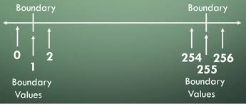
Previously we covered:
Boundary testing:
These extreme ends like:
Start - End,
Lower - Upper
Maximum - Minimum
Just Inside - Just Outside values

Slide 5
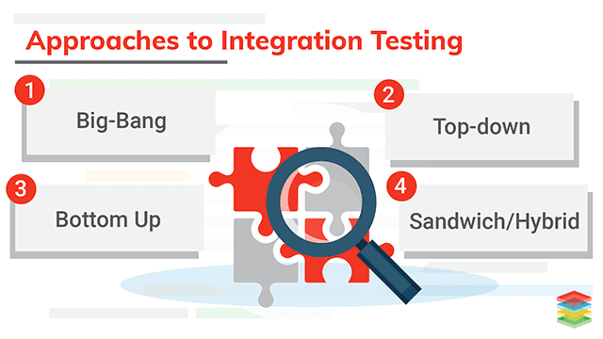
Previously we covered:
Integration testing:
software modules are integrated logically and tested as a group.
A typical software project consists of multiple software modules, coded by different programmers.
The purpose of this level of testing is to expose defects in the interaction between these software modules when they are integrated.
It is also termed as 'I & T' (Integration and Testing) or 'String Testing'.

Slide 6
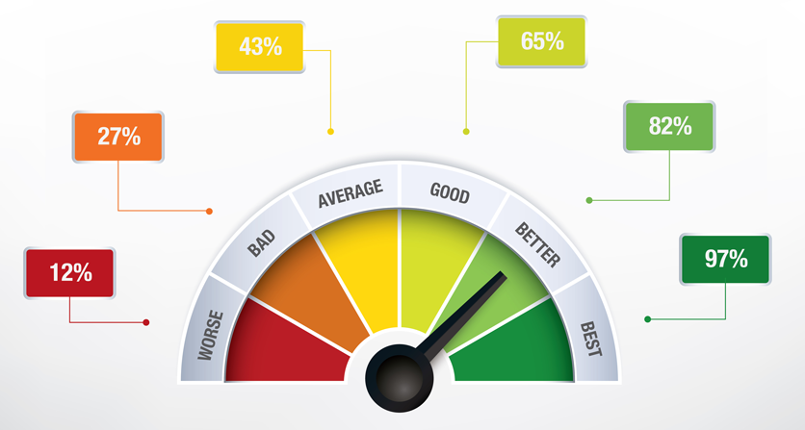
Performance testing
Performance testing is the general name for tests that check how the system behaves and performs.
Performance testing examines responsiveness, stability, scalability, reliability, speed and resource usage of your software and infrastructure.
Different types of performance tests provide you with different data.

Slide 7
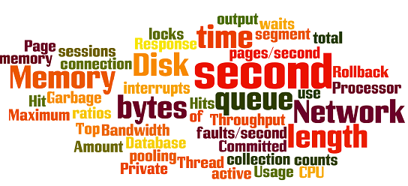
Performance testing (perf testing)
https://www.guru99.com/performance-testing.html
Before performance testing, it’s important to determine your system’s business goals, so you can tell if your system behaves satisfactorily or not according to your customers’ needs.
After running performance tests, you can analyse different Key Performance Indicator (KPIs), such as:
the number of virtual users
hits per second
errors per second
response time
Latency
bytes per second (throughput)
as well as the correlations between them. Through the reports you can identify bottlenecks, bugs and errors, an decide what needs to be done.

Slide 8
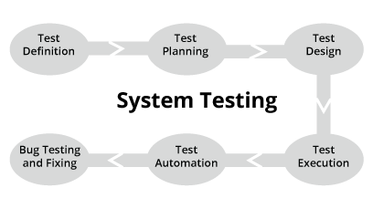
Performed on a complete integrated system to evaluate the compliance of the system with the corresponding requirements.
Components that have PASSED integration testing are inputs to system testing
Test against – system requirements specification or functional requirements specification
performed by a testing team that is independent of the development team that helps to test the quality of the system impartial
Both functional and non-functional testing.

Slide 9
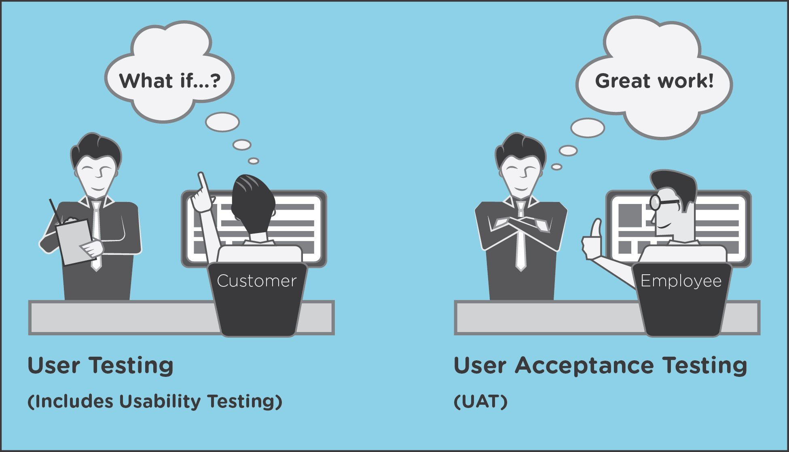
Acceptance and usability testing

Slide 10
Acceptance and usability testing
Usability testing is to be performed to ensure whether the users can use the product with ease and if it's ready to deliver.
User Acceptance Testing (UAT) is performed by the client to make sure the product is working fine and matching with agreed upon requirements.
Beta Testing is part of UAT Testing.

Slide 11
Regression testing
Whenever developers change or modify their software, even a small tweak can have unexpected consequences.
Regression testing is testing existing software applications to make sure that a change or addition hasn’t broken any existing functionality.
Its purpose is to catch bugs that may have been accidentally introduced into a new build or release candidate, and to ensure that previously eradicated bugs continue to stay dead.

Slide 12
Regression testing
By re-running testing scenarios that were originally scripted when known problems were first fixed, you can make sure that any new changes to an application haven’t resulted in a regression, or caused components that formerly worked to fail.
Such tests can be performed manually on small projects, but in most cases repeating a suite of tests each time an update is made is too time-consuming and complicated to consider, so an automated testing tool is typically required.

Slide 13
Add these tests to your training materials
Concept testing
Unit testing
Boundary testing
Integration testing
Performance testing
System testing
Acceptance and usability testing
Regressions testing

